Slide 1
PROD SUPPORT TOOL (Check INVIDI & SCAN LOGS)
By PRASHANT LAXMIKANT, Chanakya Ganguly, LIPIKA MUKHERJEE

Slide 2
SFE / CPA Request / Response Ad-IP Invidi Framework
[ Ad-IP ] Transforms OP1 Requests to Invidi ICD-14 Format Sends Request to Invidi Persists ICD-14 Request in DB Logs in – PilInvidiAdIp.log SumoLogic – AdIpCommon.log Returns Response to OP1
[Invidi ICD-14] Processes: (CreateOrder/Line UpdateOrder/Line GetOrder/Lines/Line)
REST API web/app.wsgi
This shows the basic workflow, configuration, for SFE / CPA / REST API Framework

Slide 3
SFE / CPA Prod Support Tool – GUI Tool to Support FAQs by Users
Provide answers to FAQs from Users Common Questions - Provide Details for an Order - Provide Details for an OrderLine - Provide the Lines under an Order - Scan logs to check an orderId - Scan logs to check an orderLineId - Scan logs with multiple patterns - Scan SumoLogic for Error Status - Scan SumoLogic for Time Start
Tool maps to REST API(s) provided by Ad-IP Ad-IP REST API(s) to check Invidi details and scan logs: - /checkdetails (orderId) - /checkdetails (orderLineId) - /checkorderlines (orderId)
- /scanlogs (orderId) - /scanlogs (orderLineId) - scanlogs (Pattern) This forms the base foundational configuration

Slide 4
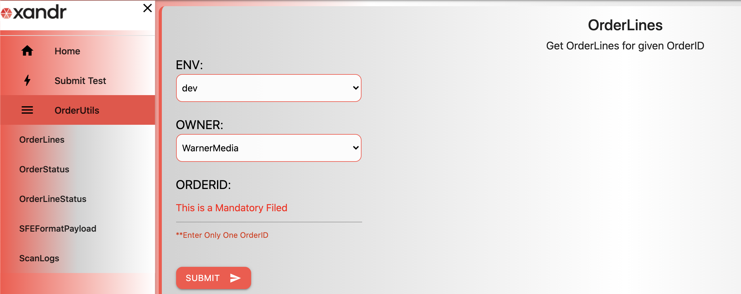
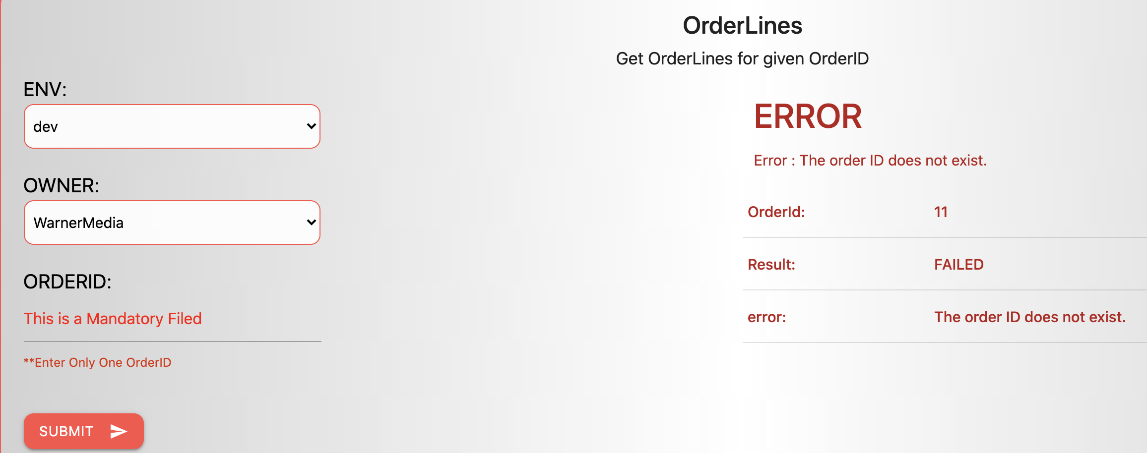
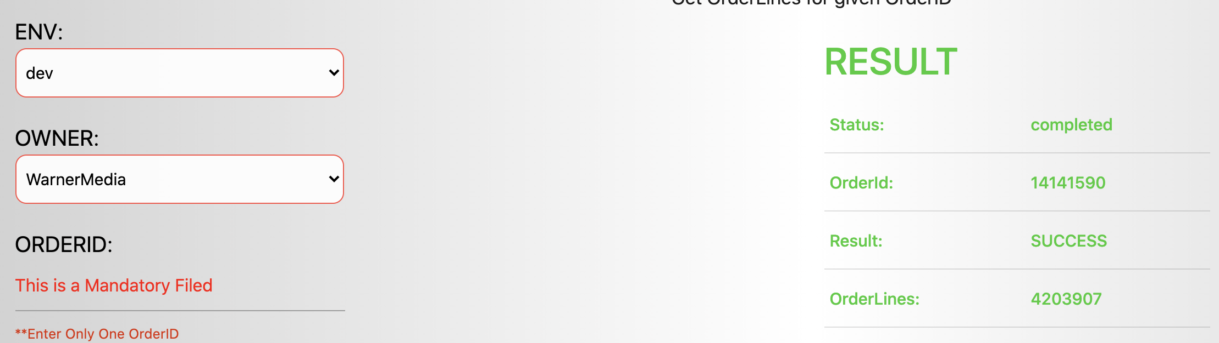
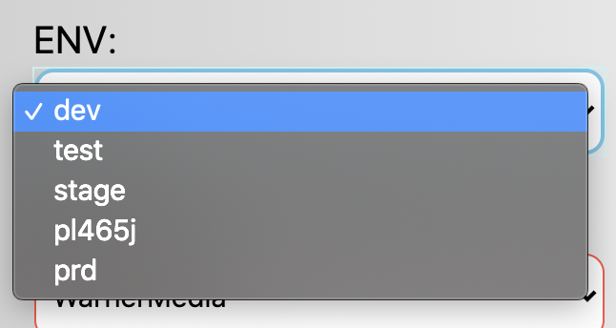
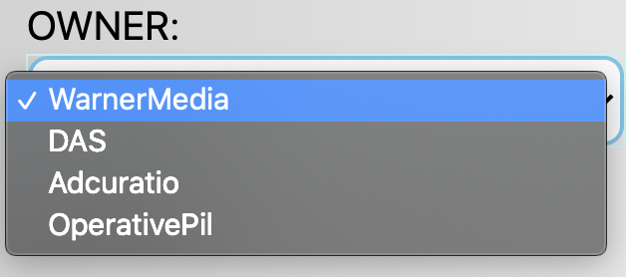
Get OrderLines
This is used to get OrderLines for given OrderID
OrderLines are fetched from Invidi
OrderId Screen Input:
OrderLineIds Screen Output:
Any Errors in response are displayed in RED
Error can be API Response Errors(HTTP non 200 Response)/Connectivity Errors
Error can be no OrderLineId’s found in Invidi for given OrderID
Error reason/message and Status(FAILED) is also displayed
Successful results are displayed in GREEN
Status(SUCCEUSS) is displayed
There could be single or multiple OrderLineIds for given OrderID
Multiple OrderLines are space separated list
Takes one OrderId at a time as Input , OrderId is a Mandatory Filed
Supports multiple owners like Operative,Warner etc. , and owner is selected from dropdown
OrderLines can be fetched from multiple environments like dev,test,stage and prod
Onclick of submit based on Env and Owner appropriate backend api’s are called and data is fetched from Invidi

Slide 5
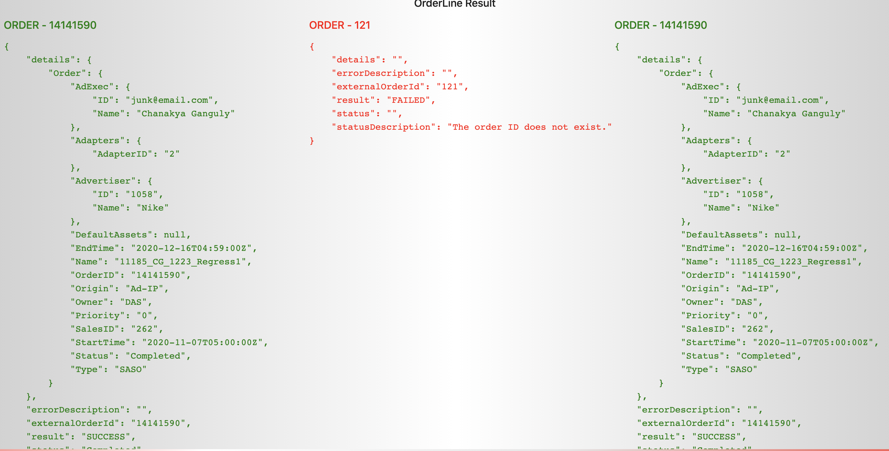
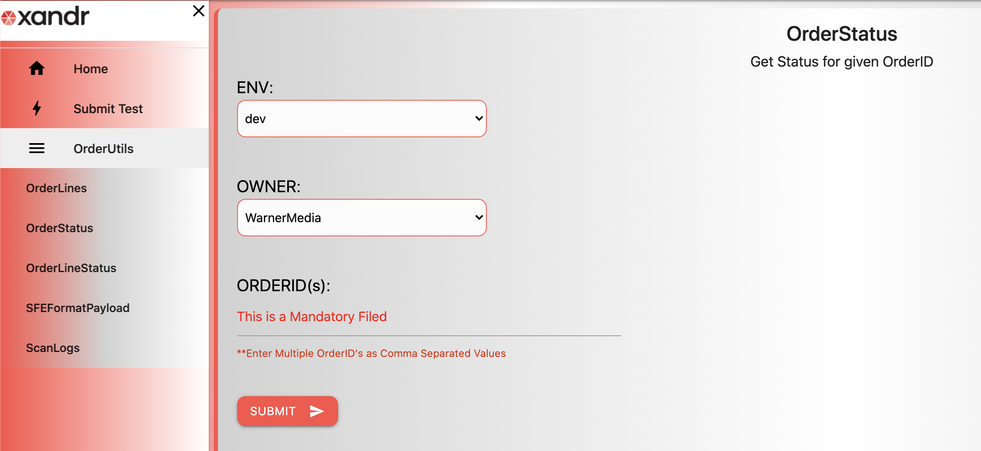
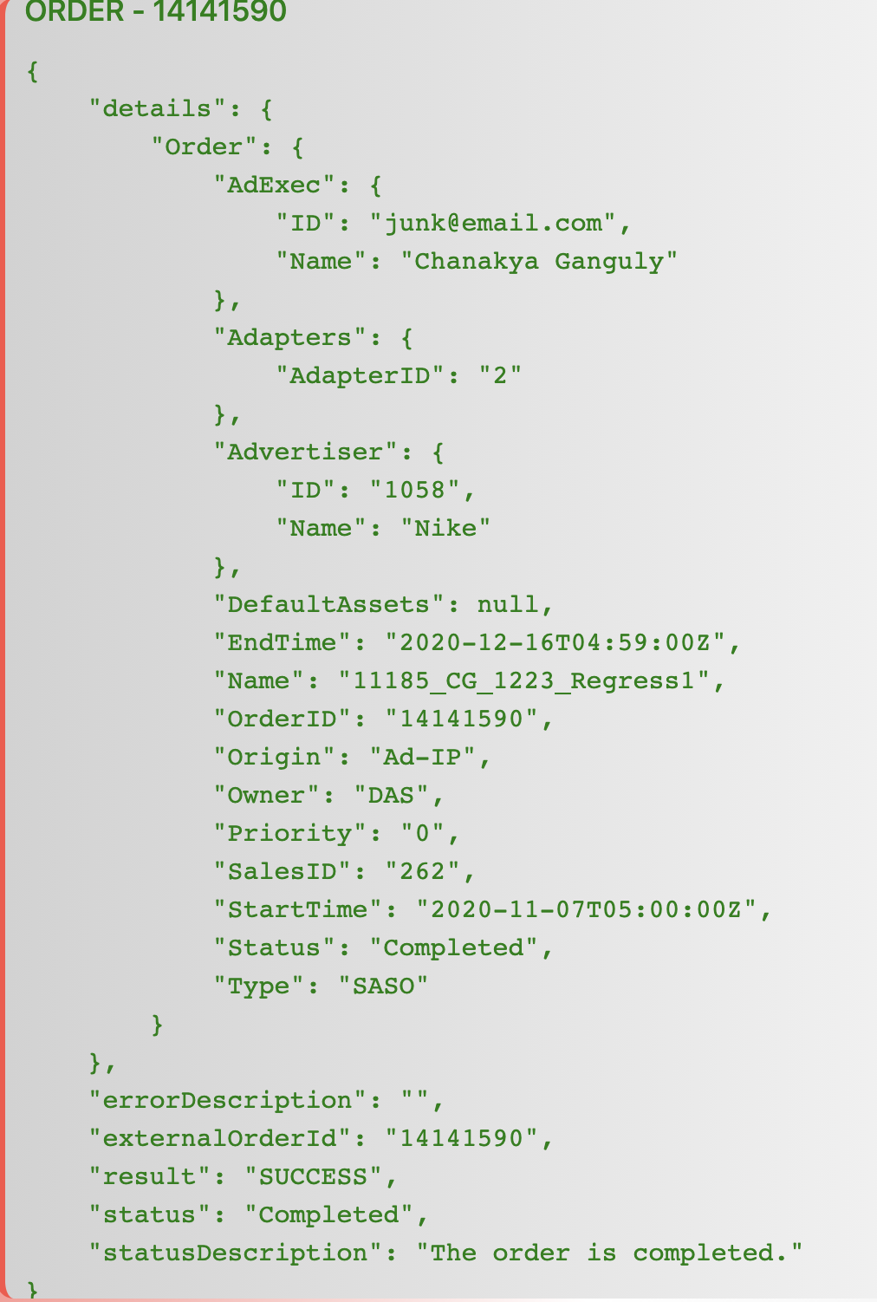
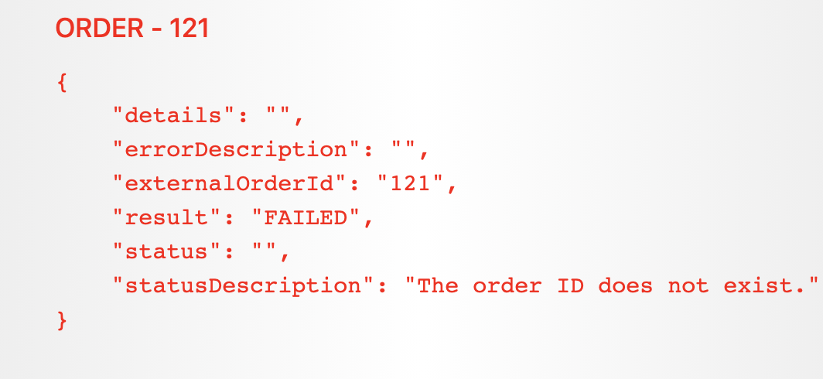
Get OrderStatus
This is used to get OrderStatus for given OrderID(s)
OrderStatus are fetched from Invidi
OrderStatus Result Screen
OrderStatus Input Screen
Results fetched from Invidi , are displayed as paginated results
3 OrderId status per page
Results are in JSON format and rendered as received from Invidi
Successful results are displayed in GREEN
Failed results are displayed in RED
Takes multiple OrderId(s) at a time as Input , OrderId(s) is a Mandatory Filed , multiple OrderIds are entered as comma separated values
Supports multiple owners like Operative,Warner etc. , and owner is selected from dropdown
OrderStatus can be fetched for multiple environments like dev,test,stage and prod
Onclick of submit based on Env and Owner appropriate backend api’s are called and data is fetched from Invidi

Slide 6
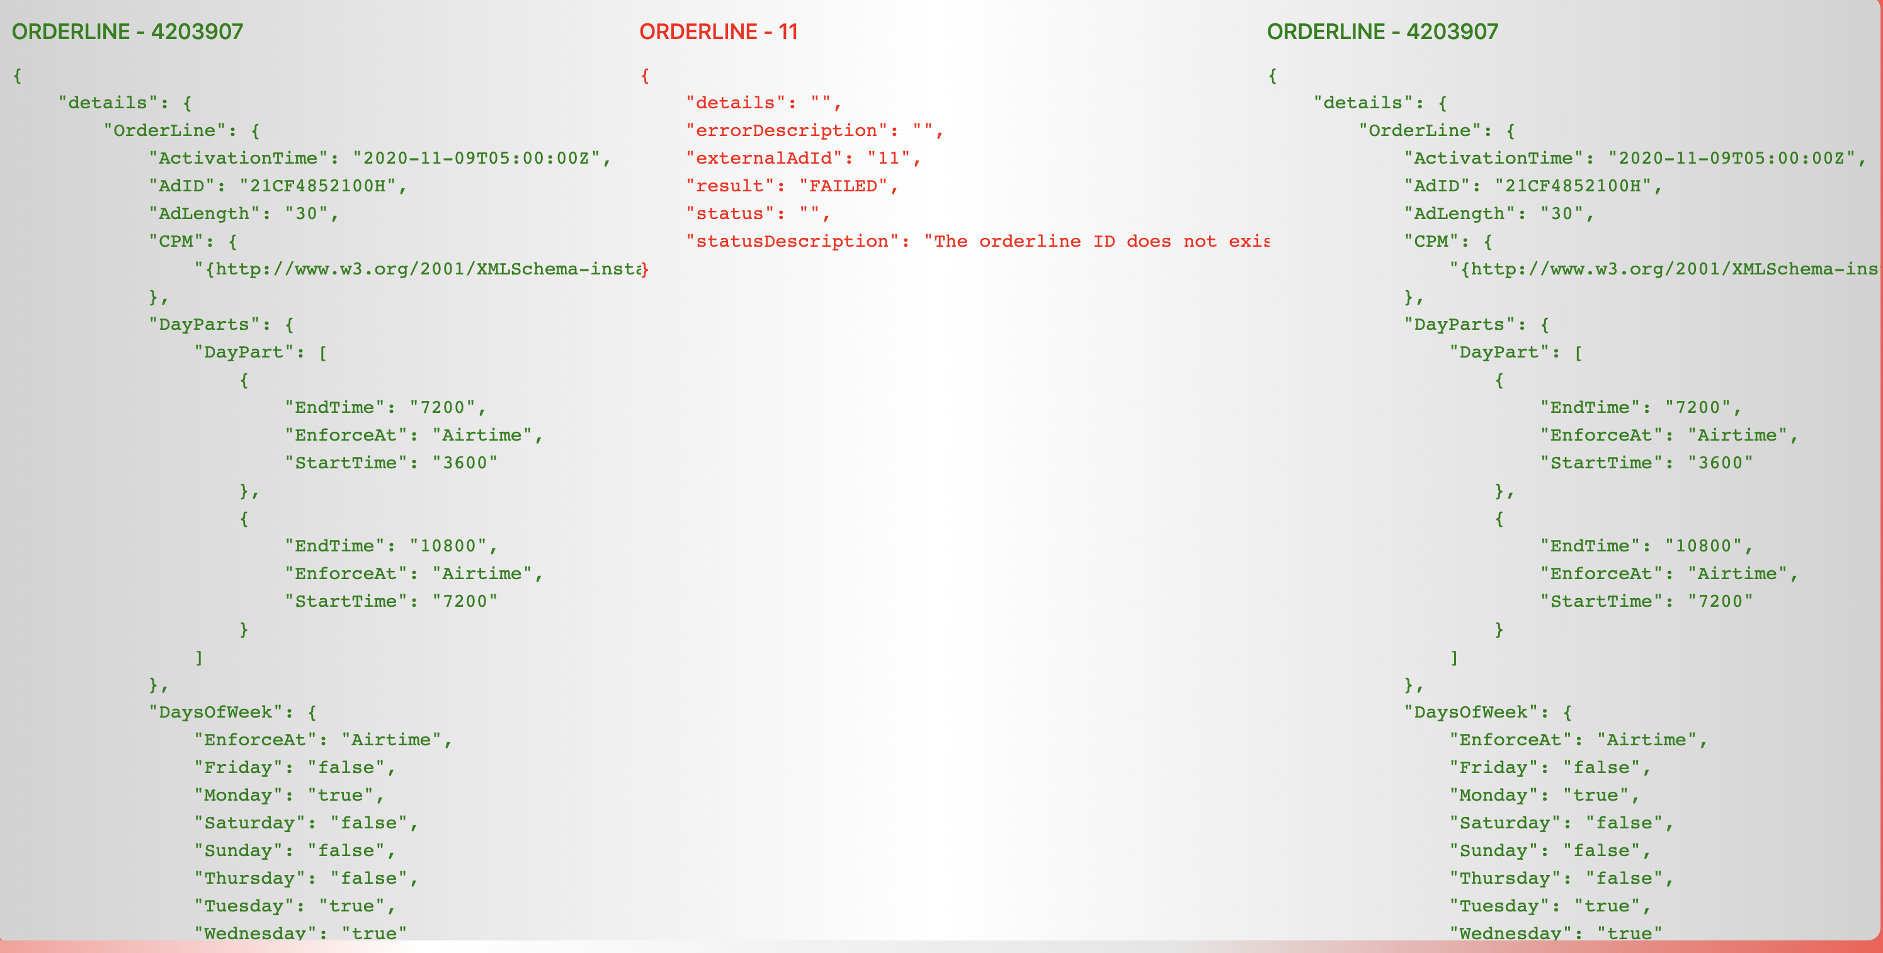
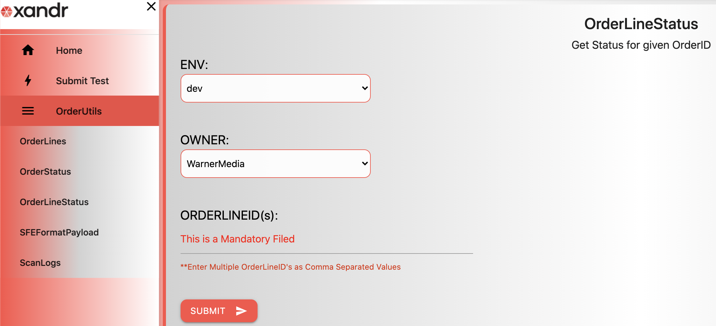
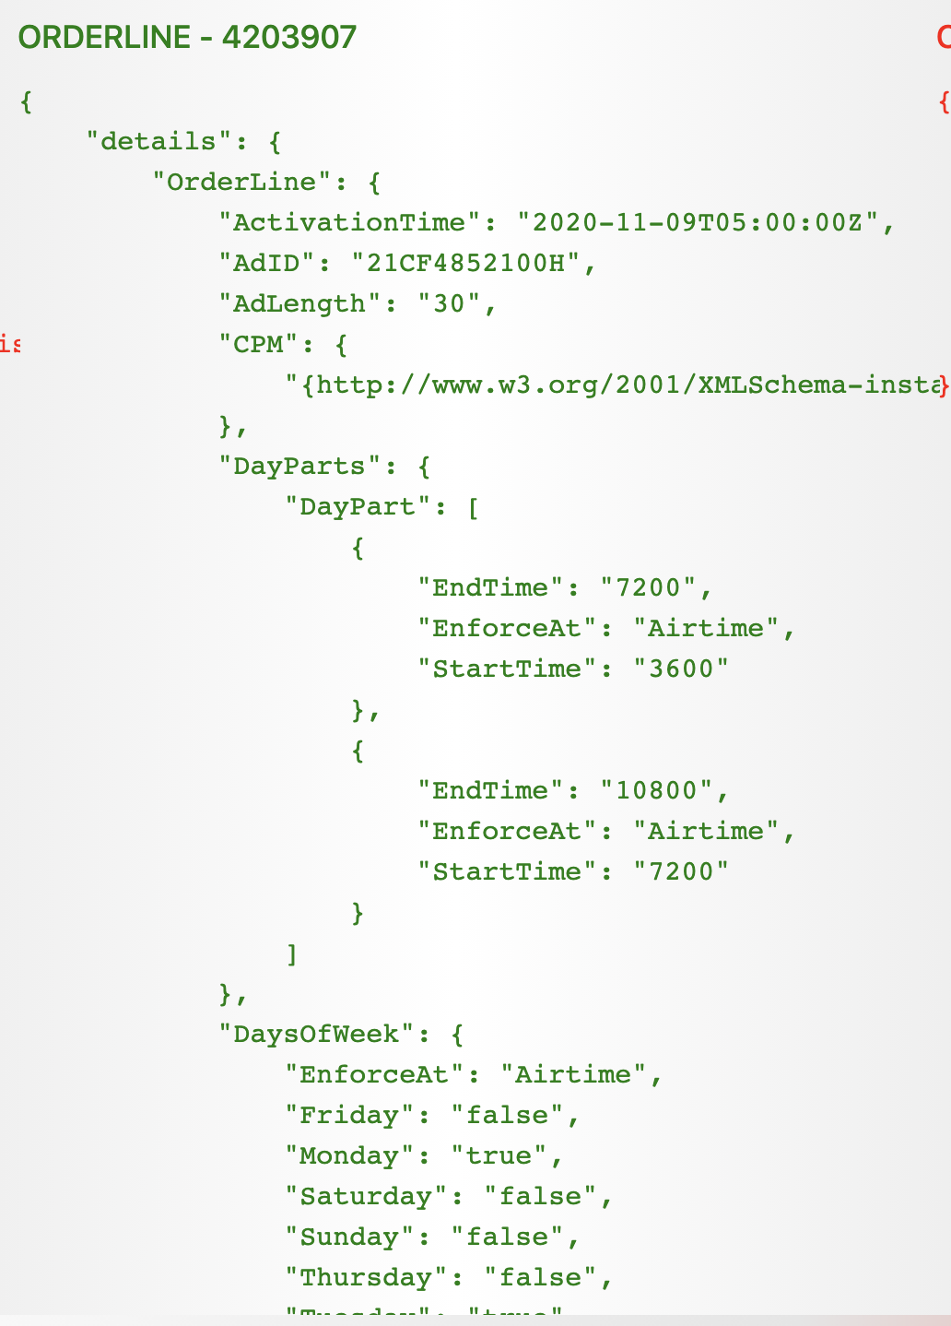
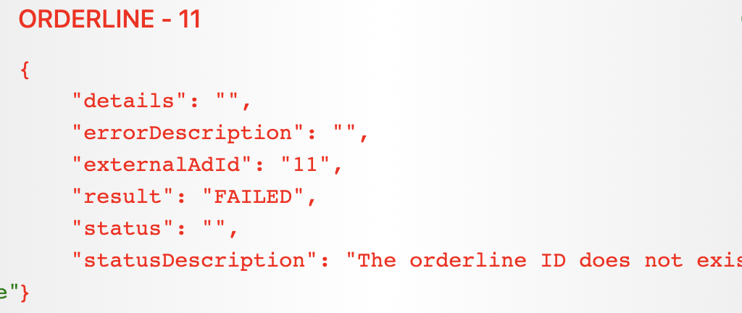
Get OrderLineStatus
This is used to get OrderLineStatus for given OrderLineID(s)
OrderLineStatus are fetched from Invidi
OrderLineStatus Result Screen
OrderLineStatus Input Screen
Results fetched from Invidi , are displayed as paginated results
3 OrderLineId status per page
Results are in JSON format and rendered as received from Invidi
Successful results are displayed in GREEN
Failed results are displayed in RED
Takes multiple OrderLineId(s) at a time as Input , OrderLineId(s) is a Mandatory Filed , multiple OrderLineIds are entered as comma separated values
Supports multiple owners like Operative,Warner etc. , and owner is selected from dropdown
OrderStatus can be fetched for multiple environments like dev,test,stage and prod
Onclick of submit based on Env and Owner appropriate backend api’s are called and data is fetched from Invidi

Slide 7
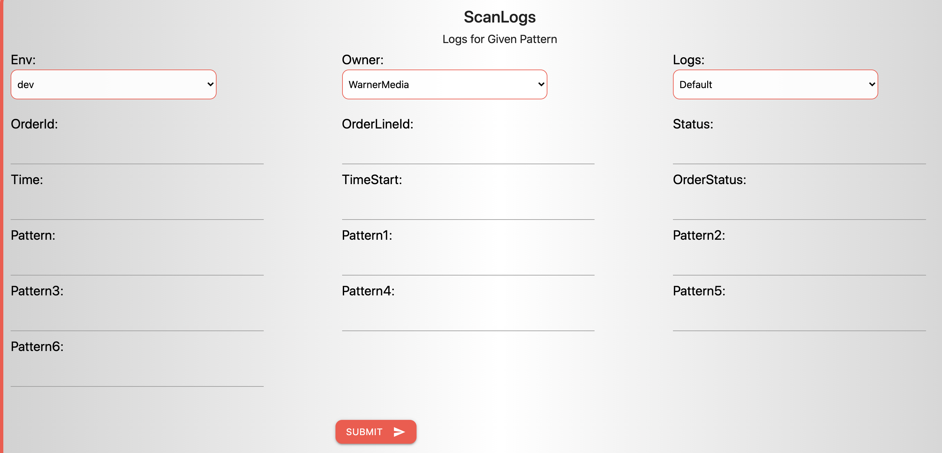
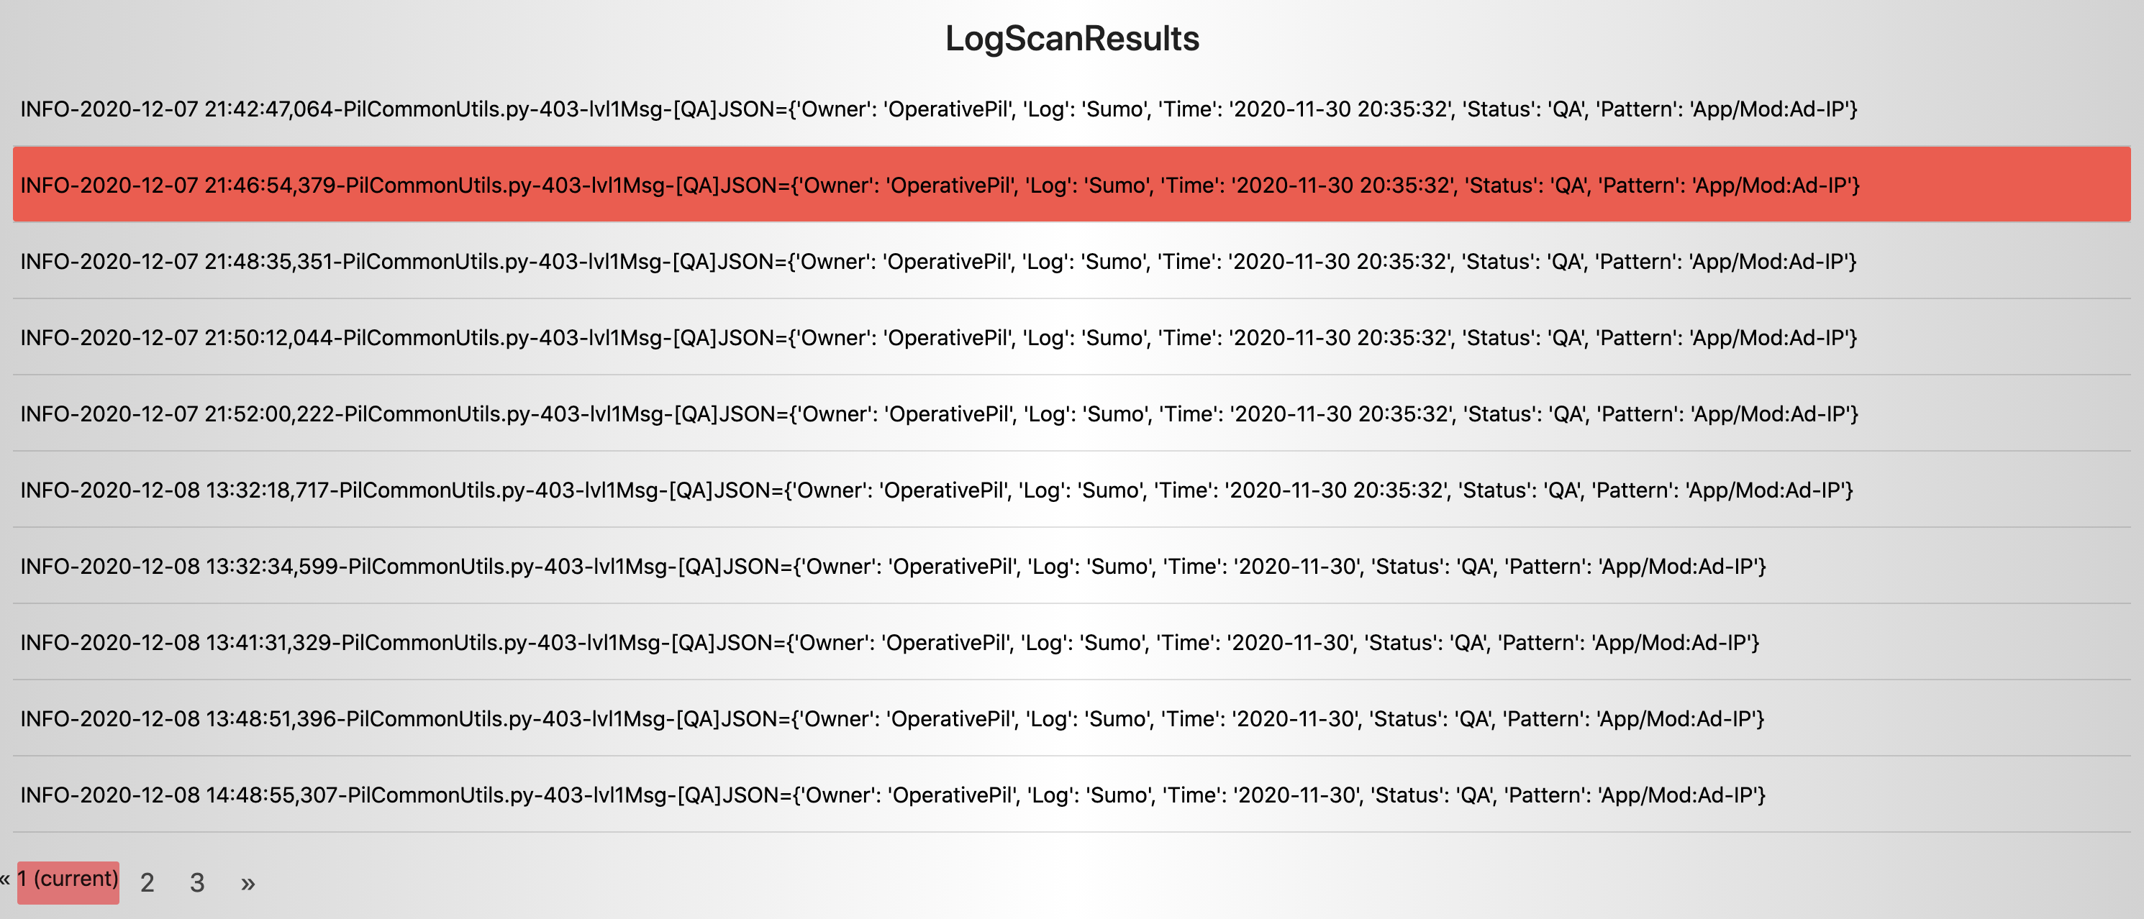
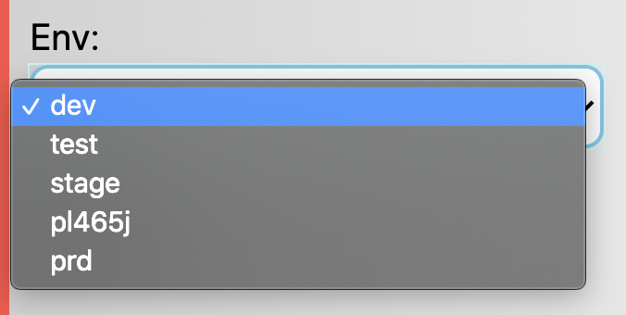
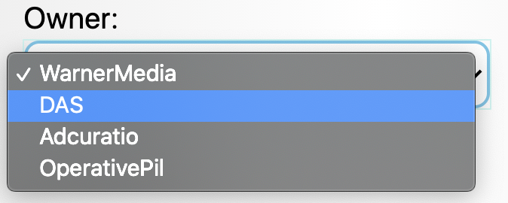
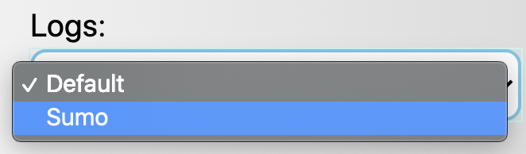
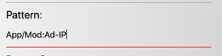
API Wrapper Scan Logs
This is used to get scan the logs, based on given patterns, and displays all the matching patterns/results
Scan Logs Input Screen
Scan Logs Output Screen
Based on the keys provided as input , loges are grepped and grep results are rendered
Results are paginated
10 results per page
Logs are retrieved based on input keys provided
Keys are grepped against selected logs and matching results are retrieved and displayed
Supports multiple owners like Operative,Warner etc. , and owner is selected from dropdown
Logs can be fetched for multiple environments like dev,test,stage and prod
Patterns can be fetched from SumoLogic Logs or Owner Specific logs(Default Logs)
Onclick of submit based on Env and Owner appropriate backend api’s are called and data is fetched from appropriate logs
Following keys are provided for searching logs
How inputs are resolved to grep patterns
Input :
"Owner": "OperativePil",
"Log": "Default",
"orderId": "14141673",
"orderStatus": "Unapproved"
grep pattern:
grep JSON= PilAdIpInvidi.log* | grep "'orderId': '14141673'| grep "'orderStatus': 'Unapproved'" | grep -v grep
OrderId | Order ID
OrderLineId | OrderLine ID
OrderStatus | Order Status
TimeStart | Order Start Time
Status | Status
Pattern | Generic Patterns

Slide 8
Prod Support Framework - for ALL Owners – System Reliability Engg
Framework UI Checklist - Check Order/Line Details from Invidi - Get Order/Line in SFE OP1 Format - Scan Sumo-Logic/Owner Log Pattern to add multiple, add: Pattern1, Pattern2
5 Types of Patterns: [a] /scanlogs for orderId:
{ "Owner": "OperativePil", "Log": "Default", "orderId": "14141673“, "orderStatus": "Unapproved " } % grep JSON= PilAdIpInvidi.log* | grep "'orderId': '14141673'" | grep "'orderStatus': 'Unapproved'" [b] /scanlogs for lineitemId:
{ "Owner": "OperativePil“, "Log“, "Default", "lineitemId": "4204101", "Pattern": "unapproved " } % grep JSON= PilAdIpInvidi.log* | grep "'lineitemId': '4204101'" | grep "unapproved"
Multiple scanlogs pattern types (contd): [c] /scanlogs for a certain Pattern:
{ "Owner": "OperativePil", "Log": "Default", "Pattern": "'externalAdId': '4204133', 'status': 'Active’" } % grep "'externalAdId': '4204133', 'status': 'Active'" PilAdIpInvidi.log* [i] /scanlogs SumoLogic log for Time, Status, Pattern:
{ "Owner": "OperativePil", "Log": "Sumo", "Time": "2020-11-30 20:35:32", "Status": "QA", "Pattern": "App/Mod:Ad-IP" } % grep FFF5555 AdIpCommon.log | grep "Time:2020-11-30 20:35:32" | grep "Status:QA" | grep "App/Mod:Ad-IP"
[ii] /scanlogs SumoLogic log for Time, Status, Start: { "Owner": "OperativePil", "Log": "Sumo", "Time": "2020-11-30", "TimeStart": "2020-11-30 20:33:49", "Status": "QA", "Pattern": "App/Mod:Ad-IP " } % grep FFF5555 AdIpCommon.log | grep "Time:2020-11-30 20:35:32" | grep "Status:QA" | grep "App/Mod:Ad-IP"

